Slide 1


LIFE EXPECTANCY IN THE UK
Supreeth Gowda

Slide 2

CONTENTS
01
INTRODUCTION
02
METHODOLOGY
03
KEY FINDINGS
04
CAUSES OF DEPRIVATION
05
TARGETED SOLUTIONS
06
FUTURE WORK
07
CONCLUSION

Slide 3
INTRODUCTION
Understand how socioeconomic factors influence life expectancy.
Highlight disparities across England with a focus on low-income families.
To identify geographic inequality in life expectancy within the UK.
Provide targeted solutions to address inequalities
OBJECTIVES
KEY FACTORS ANALYZED
Life expectancy, net annual income, deprivation rate, homelessness, and deaths due to alcohol.
Fingertips
Office for National Statistics (ONS)
National Health Service(NHS)
INFO SOURCES

Slide 4

METHODOLOGY
01
02
03
ETL
STATISTICAL/VISUAL ANALYSIS
DISCUSS KEY FINDINGS
Loading, Cleaning and Transforming the datasets to ensure accurate merging
Analyse the data and extract key factors affecting life expectancy.
Findings are analyzed and potential solutions are provided

Slide 5
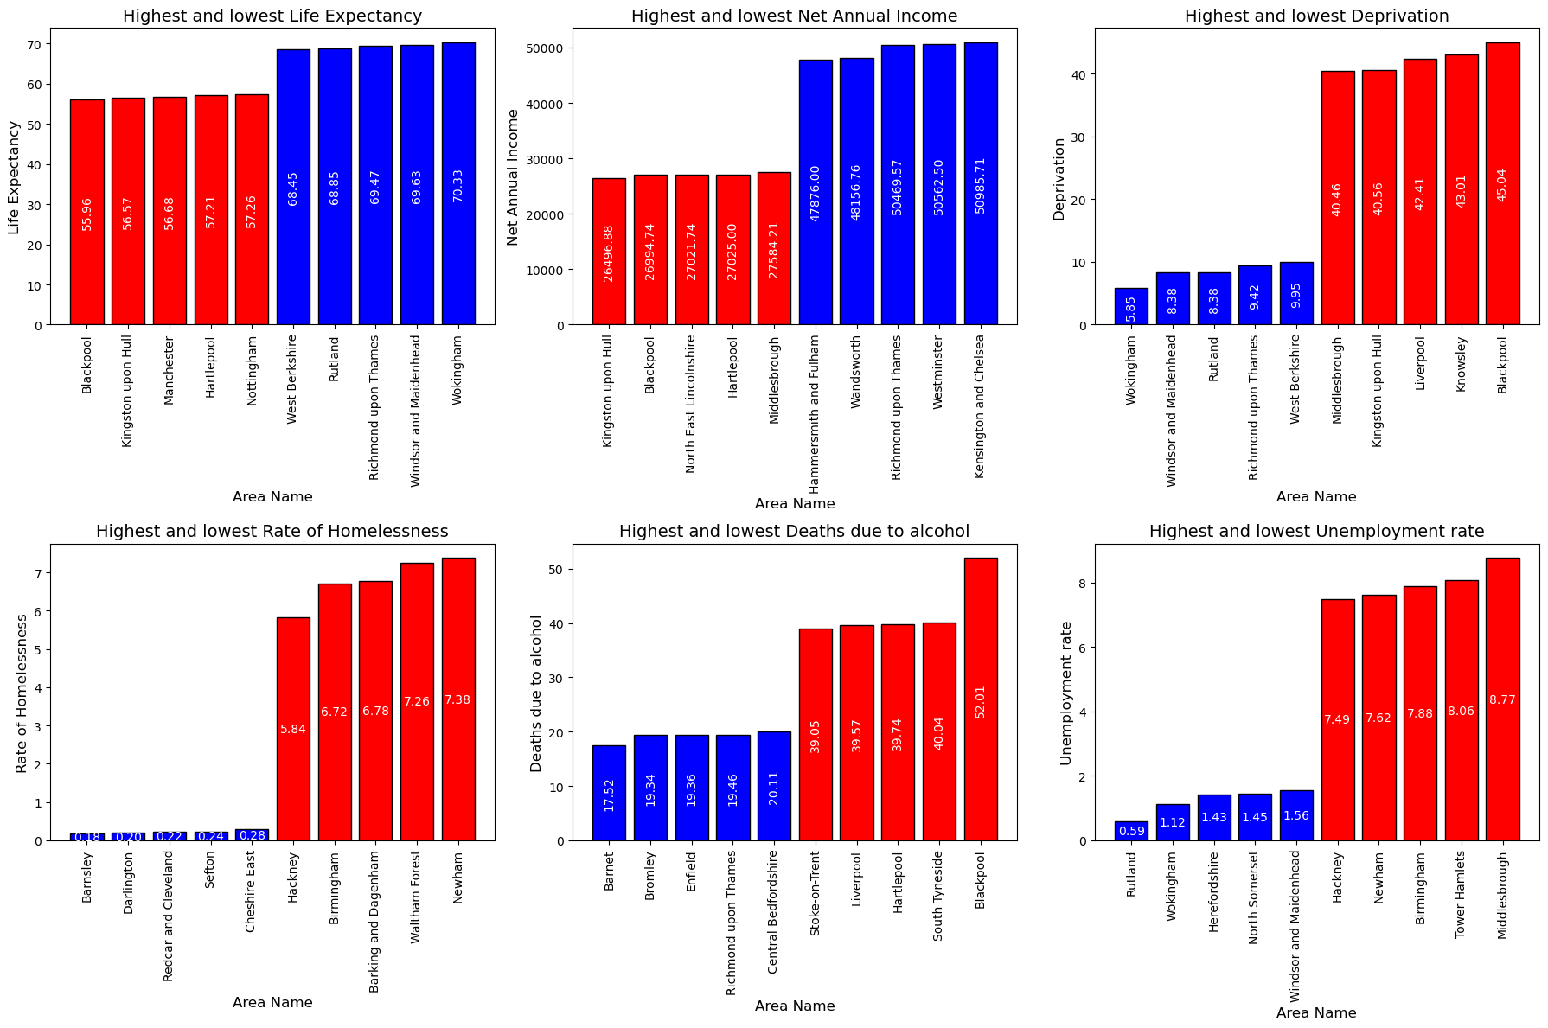
KEY FINDINGS
Areas with highest deprivation have higher alcoholism and unemployment lowering life expectancy

Slide 6
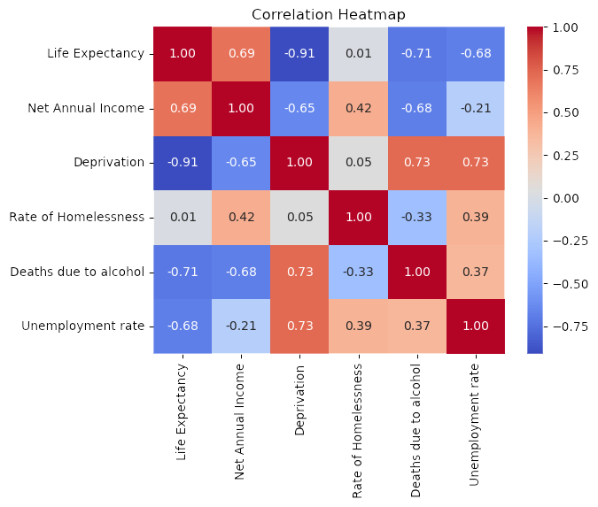
KEY FINDINGS
Strong correlation between multiple factors
Deprivation - LE
Alcoholism - LE
Unemployment - LE
Annual Income - Alcoholism

Slide 7
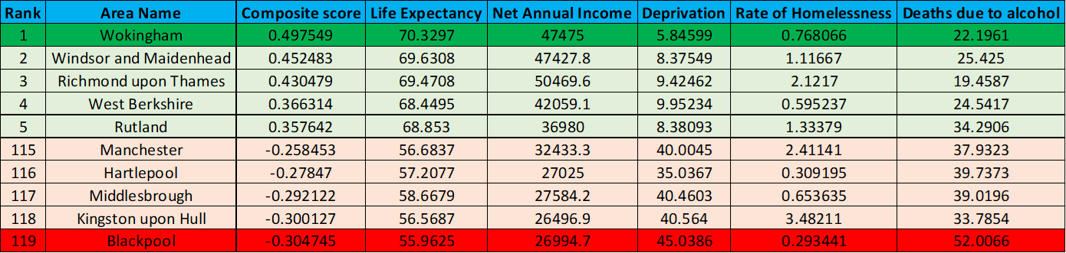
KEY FINDINGS
Top areas (Wokingham, Windsor) show both high income (£47,000+) and life expectancy (70+ years).
Bottom areas (Blackpool, Kingston upon Hull) show both low income (£26,000-£27,000) and life expectancy (55-56 years).
Composite Score = i∑​(wi​×Normalized Xi​)
where, w is the weight assigned to factor and Xi is the factor value
[Factors are added if positive and subtracted if negative based on factor type
Ex: Annual Income is added whereas, Deprivation is subracted]

Slide 8
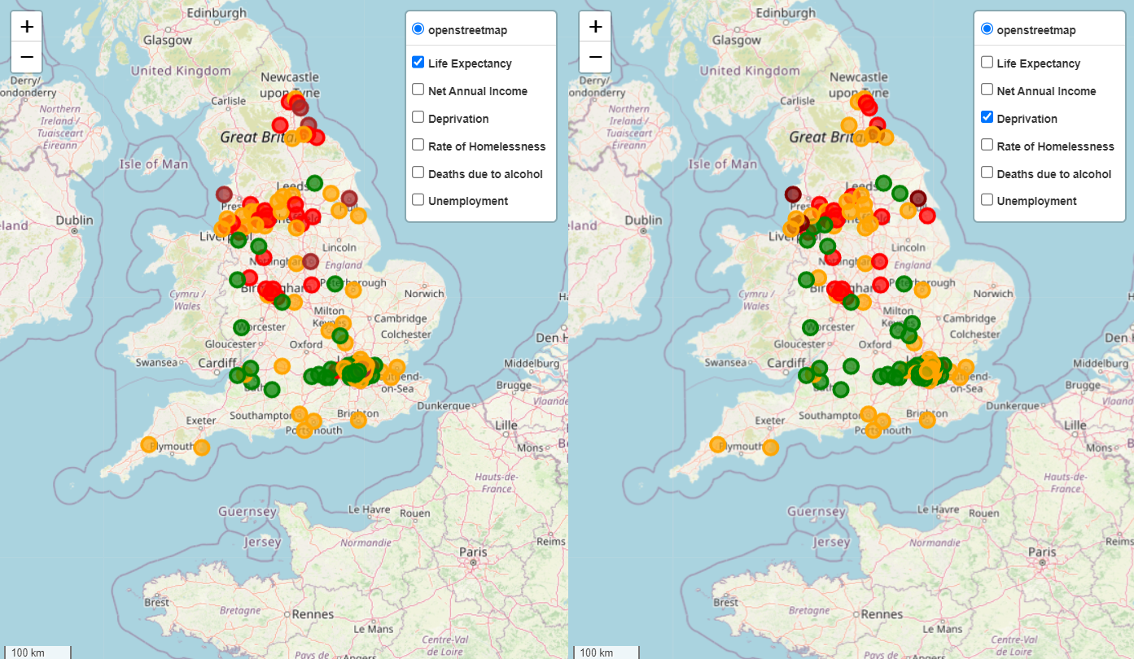
GREEN (HIGHEST) -> MAROON (LOWEST)
Lower life expectancy and high deprivation rates are present in North part of England
KEY FINDINGS

Slide 9
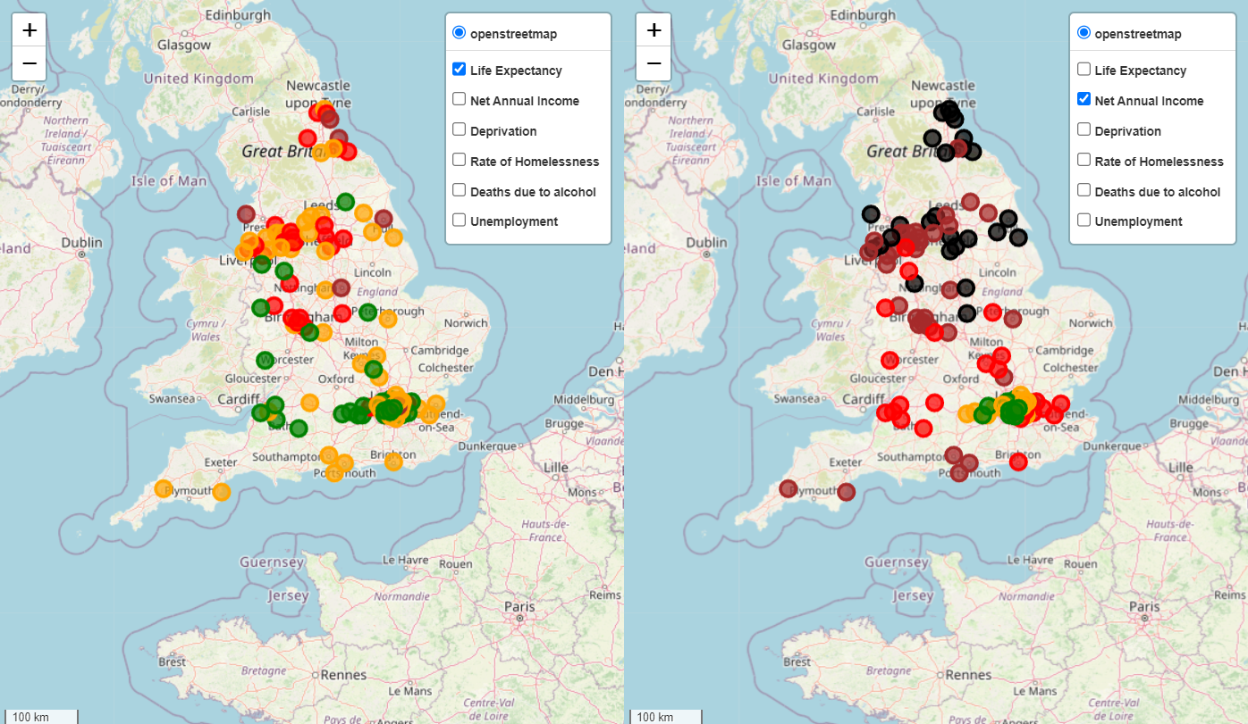
GREEN (HIGHEST) -> BLACK (LOWEST)
Similarly, lower Annual Income is also present in North part of England
KEY FINDINGS

Slide 10







CAUSES OF DEPRIVATION
HISTORICAL INDUSTRIAL DECLINE
INVESTMENT DISPARITIES
EDUCATION AND SKILLS GAP
HEALTH INFRASTRUCTURE
HOUSING MARKET DYNAMICS
POLICY CENTRALIZATION

Slide 11





TARGETED SOLUTIONS
HEALTHCARE INVESTMENT
ACCESS TO EDUCATION
CHANGES TO POLICIES
EARLY INTERVENTION PROGRAMS
BETTER ECONOMIC DEVELOPMENTS

Slide 12





Temporal Analysis
Healthcare Access Mapping
FUTURE WORK
Social Health/Education Tracking
Environmental Impact
International Benchmarking

Slide 13







CONCLUSION
1
2
3
Life expectancy gaps represent one of our most serious social challenges.
Data shows clear links between economic inequality and health outcomes which needs to be addressed as it is crucial for improving life expectancy.
Action is needed at both policy and community levels.

Slide 14
THANK YOU

